Slide 1
Metals Dashboards and LG M48F Supply Plan Overview
Chiemi Kato
December 2019

Slide 2
Introduction
Metals Dashboards
LG M48F Supply Plan
Sarah was using a dashboard that came with a long list of constraints
Wanted to transition the dashboard to a different program that would be able to create a more robust user interface that would auto upload
LG Chem signed a contract to produce batteries for Tesla products at GF3 in late 2018.
Our team started working with LG Chem on this project ____
Challenges:
No framework for communication or operational analysis between Tesla and LG
We weren’t exactly sure how our vehicle production and sale would be impacted by LG’s production capacity

Slide 3
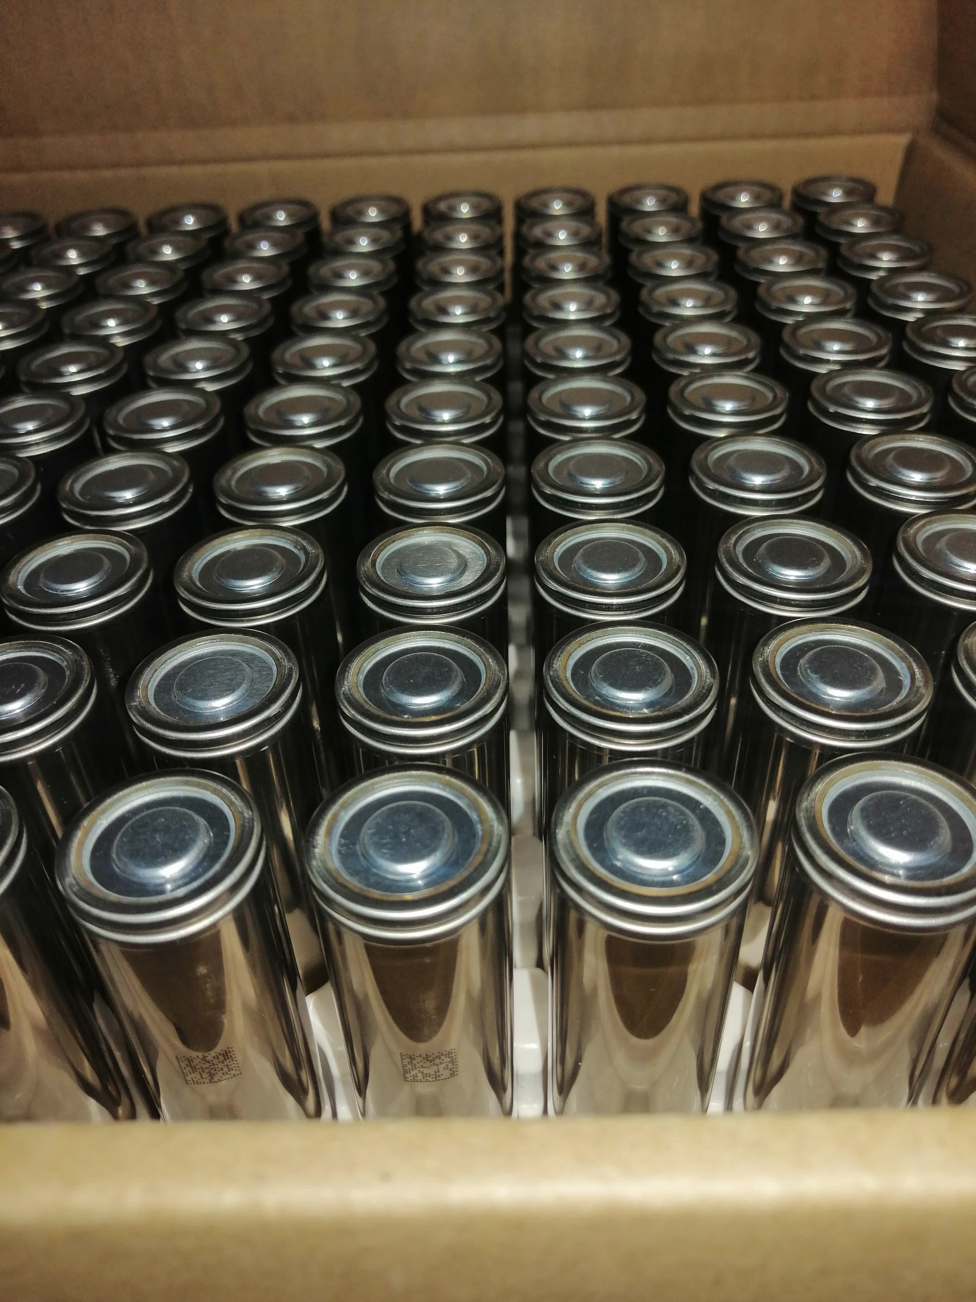
LG M48F Supply Plan Process/Improvements
Toggles to identify and simulate how supply will be impacted by design changes
Set up framework for LG to be able to provide more details (ie weekly production data and by assembly line)
Integrated/consolidated information from finance to provide different demand-side scenarios
Agreed with LG on a calendar formatting structure and also to pass the file back and forth to improve process
LG did the rest and I worked with them to improve and fix any errors from the new system

Slide 4
3. Outcome – What is the improvement -DEMO
Show toggles…and walk through the PIPELINE of how information gets filtered into SUMMARY page
How I taught myself the operations by learning from the excel file (EXAMPLES)
(purpose I was able to gather information to create detailed SP for other teams to understand and use as tools to simulate their own ideas)

Slide 5
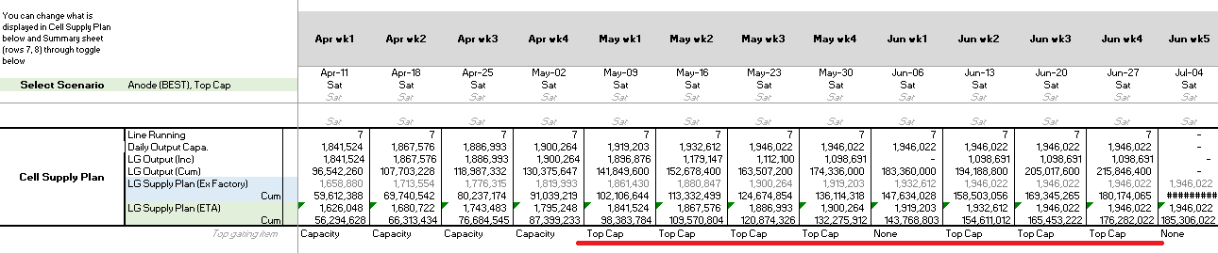
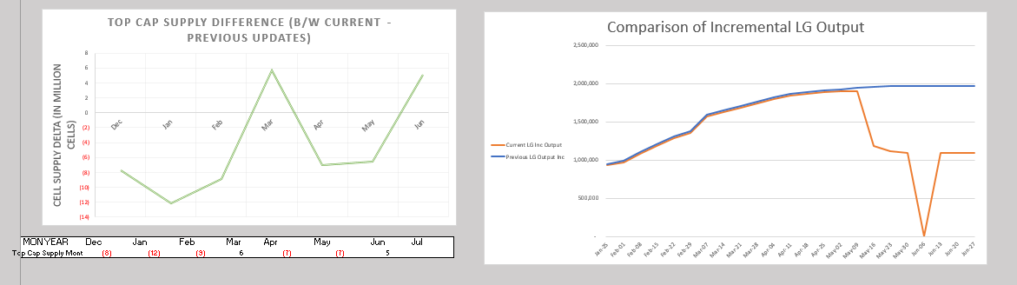

Slide 6
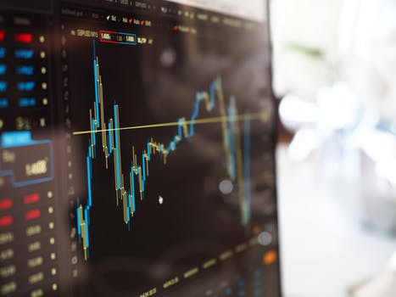
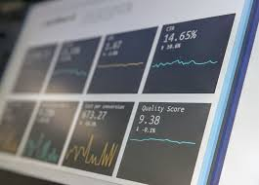


Metals Dashboards Process/Improvements
-Restructured the way source files were stored so that visualizations would not be disrupted with updated data
- Reorganized the source files to be consolidated into only a few excel sheets and then converted data tables in to a SQL database which can be easily updated with replaced information without disrupting the visualizations
Used python to automate a lot of the data transformations and cleaning

Slide 7
Final Benefit
A lot more room for growth by allowing for enhanced sharing capacities, via Power BI online and Sharepoints integration
Created new dashboards and interactive functionality
All of the automation is done within OneDrive cloud so that it can be completed by other team members as well
Saves time

Slide 8
Nickel Price Forecasting Using Regression Process/Improvements/Benefits
- Model assumes serially correlated daily pricings (ie yesterday’s Nickel price has a relationship to today’s price)
-Automated data pipeline implements
- webscraping from LME website itself
- automated data cleaning/preprocessing (time reformatting for business days)
- automated parameter optimization through grid searching (matrix iterations)
- automated database updates that recreate the visualizations every time the model is run
-Provides an additional tool for Sarah and team to use alongside other tools to help make educated guesses to inform business strategy

Slide 9
Demo – Web Scrape
ddd

Slide 10
NOTES:
Add more info about data pipelining + sharing capacities
More screenshots and charts?
Info about price forecasting / Process
DEMO work/steps organize

Slide 11
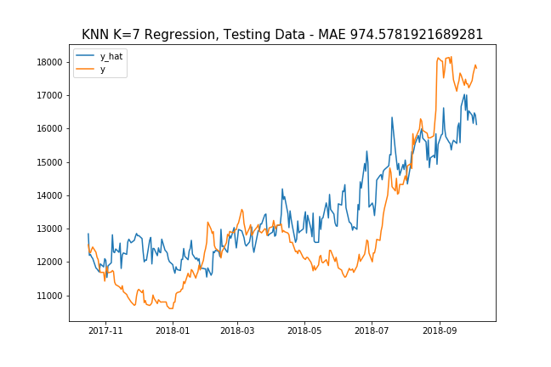
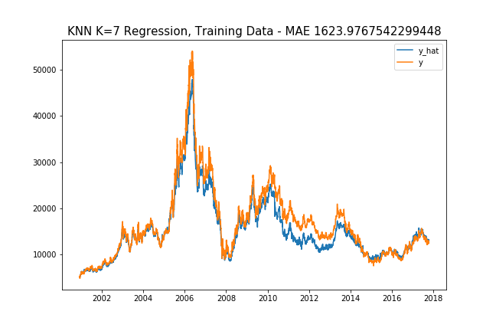
Selected Result Graphs… Below is graph of 10 lags, lag length = 4 weeks, rolling window length = 4 weeks

Slide 12
Additional / Exogenous Variables
China GDP
GDP per Capita
GDP per Capita Growth
China Overall Consumption
Consumption Expenditure
Consumption Expenditure (by GDP)
Time
Days of Month
Both
Weeks of Year
Global Nickel Production
Global Nickel Prod.
week of year, global nickel prod, consumption div gdp CHINA, no gdp!

Slide 13
Turning Time Series into Supervised Learning

Slide 14
References
TIME SERIES ANALYSIS training testing:
https://stats.stackexchange.com/questions/346907/splitting-time-series-data-into-train-test-validation-sets
About “Day Forward Chaining”
https://towardsdatascience.com/time-series-nested-cross-validation-76adba623eb9
Good KNN Explanation:
https://towardsdatascience.com/machine-learning-basics-with-the-k-nearest-neighbors-algorithm-6a6e71d01761

Slide 15
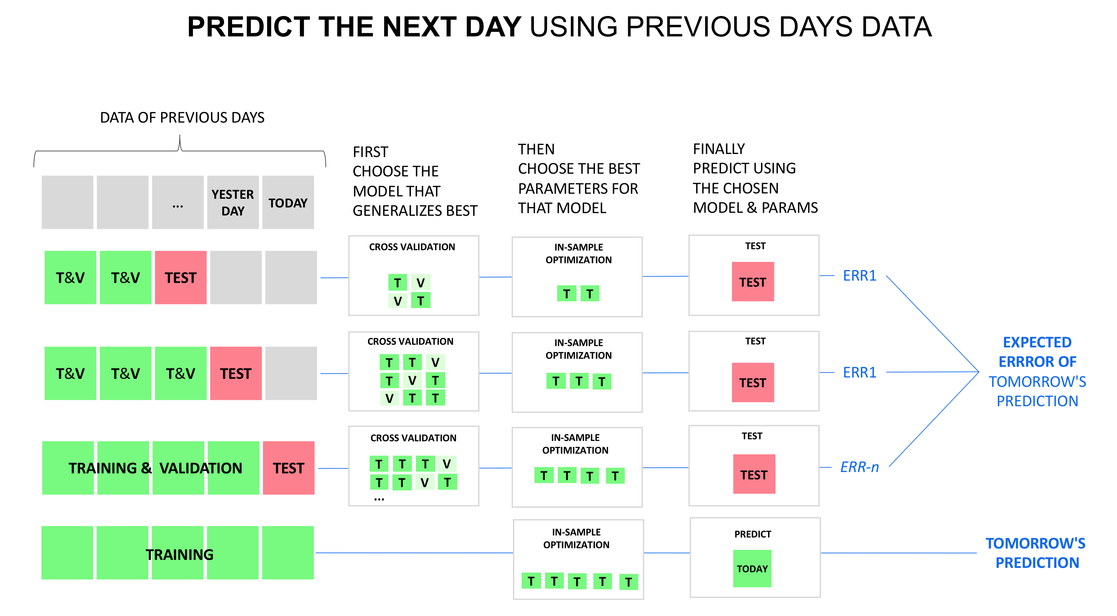

Slide 16
Background & Challenges
Background: LG has been working with Tesla for around a decade on small volume battery operations like Powerwall
In late 2018 they signed a deal with Tesla for their first mass production assembly of battery products at Gigafactory 3
When I joined the project in September, I was assigned to work on the M48F supply ramp up plan there were many things to be improved -- really was no framework for how we were to communicate and collaborate with LG on a PRODUCTION LEVEL
At that time, we were provided with limited monthly information about cell supply and component capacity
CHALLENGE: There was no framework for communication or operational analysis between Tesla and LG and we weren’t exactly sure how our vehicle production and sale would be impacted by LG’s production capacity

